Slide 1

Notes:
Reload codespace
Uncheck VS Code tabs

Slide 2
This is CS50
If you didn't get a rubber duck 🦆 last week, ask Kelly during break or after class!
Today's snacks, Hello Panda Chocolate Biscuits. 🐼 🍫
Do say hi or ask questions during break or after class!
What do today's binary bulbs spell?

Slide 3
Notes:
Reload codespace
Uncheck VS Code tabs

Slide 4
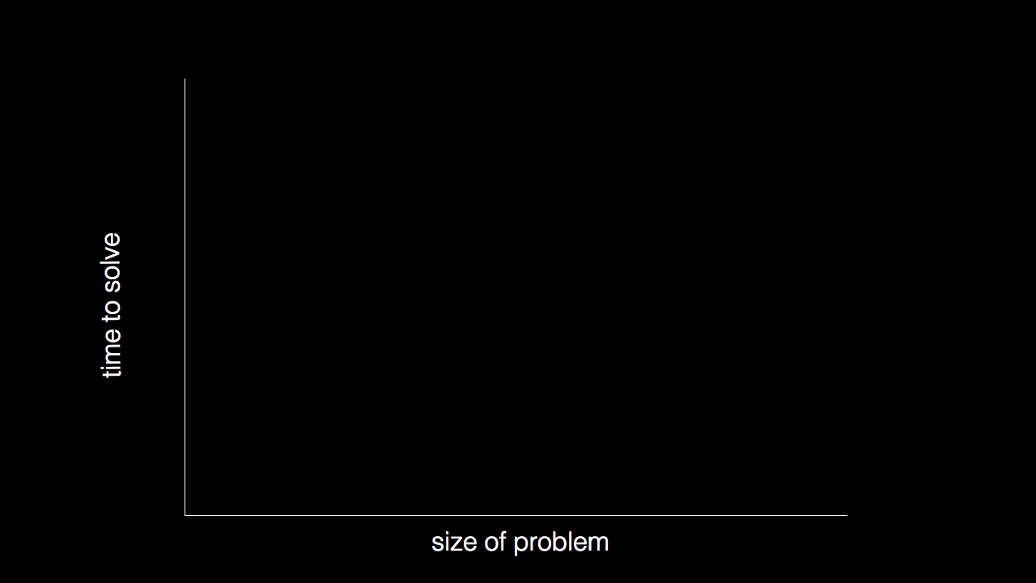

Slide 5
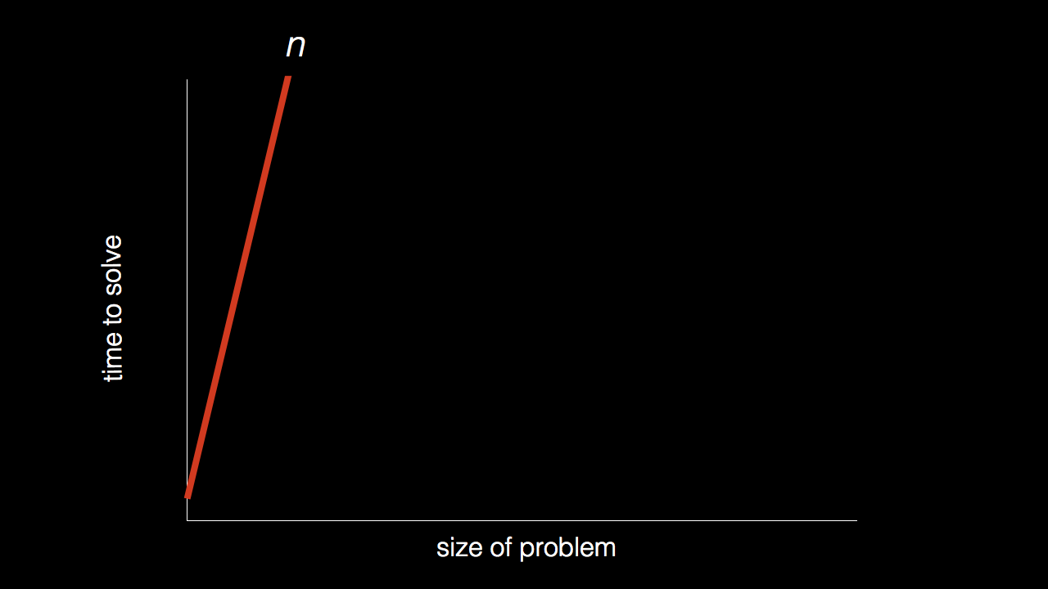
n

Slide 6
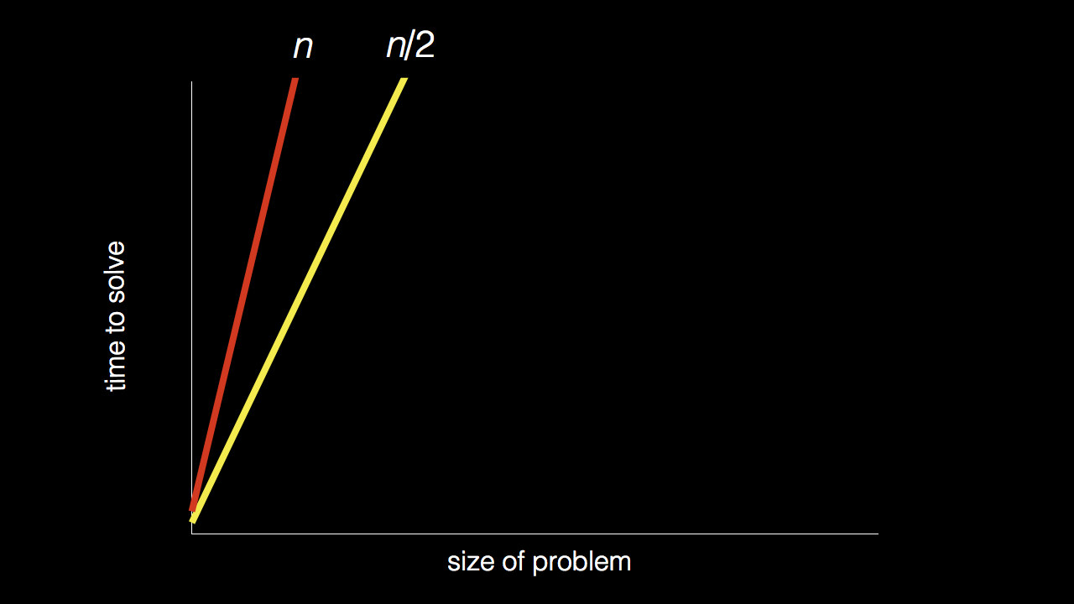
n
n/2

Slide 7
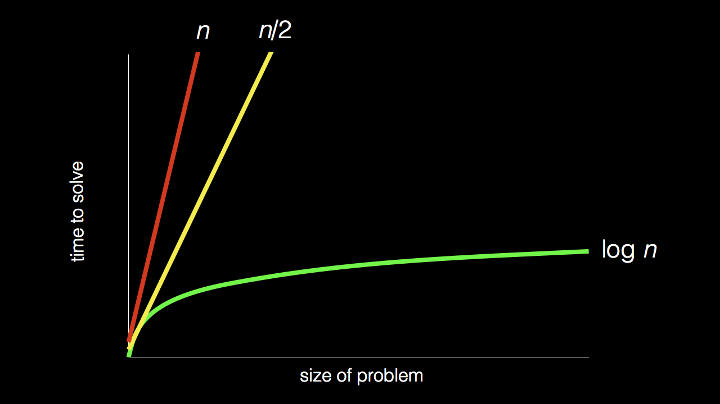
n
n/2
log₂ n

Slide 8
Stand up and think of the number 1.

Slide 9
Stand up and think of the number 1.
Pair off with someone standing, add their number to yours, and remember the sum.

Slide 10
Stand up and think of the number 1.
Pair off with someone standing, add their number to yours, and remember the sum.
One of you should then sit down.

Slide 11
Stand up and think of the number 1.
Pair off with someone standing, add their number to yours, and remember the sum.
One of you should then sit down.
If still standing, go back to step 2.

Slide 12

Notes:
https://apps.apple.com/us/app/contacts/id1069512615#?platform=iphone
In Week 0, intuitive algorithms…
John Harvard

Slide 13
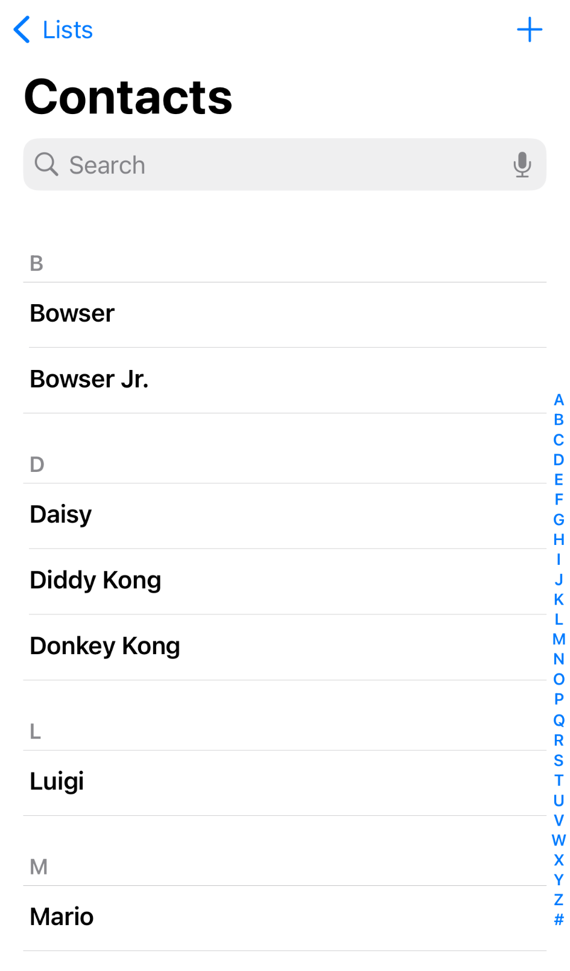
Notes:
https://nintendo.fandom.com/wiki/Nintendo_characters#Mario_series_(including_sub-franchises)

Slide 14
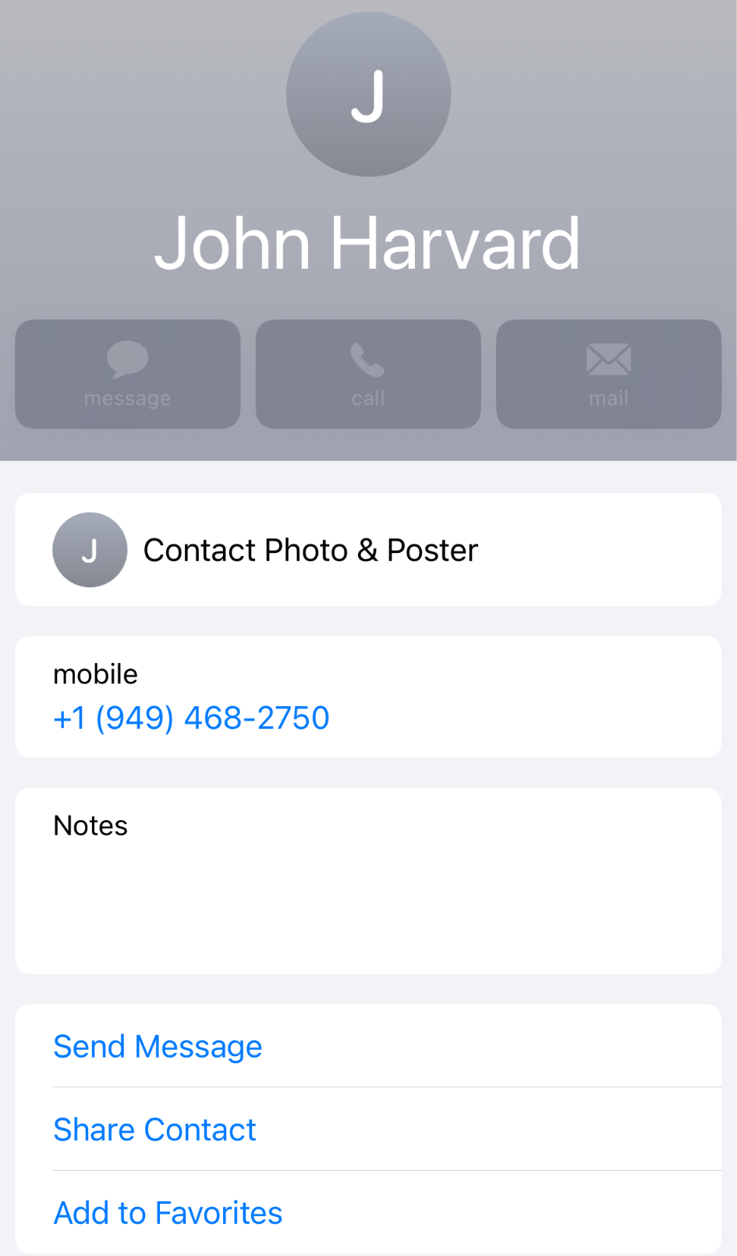

Slide 15
n

Slide 16
n
n/2

Slide 17
n
n/2
log₂ n

Slide 18
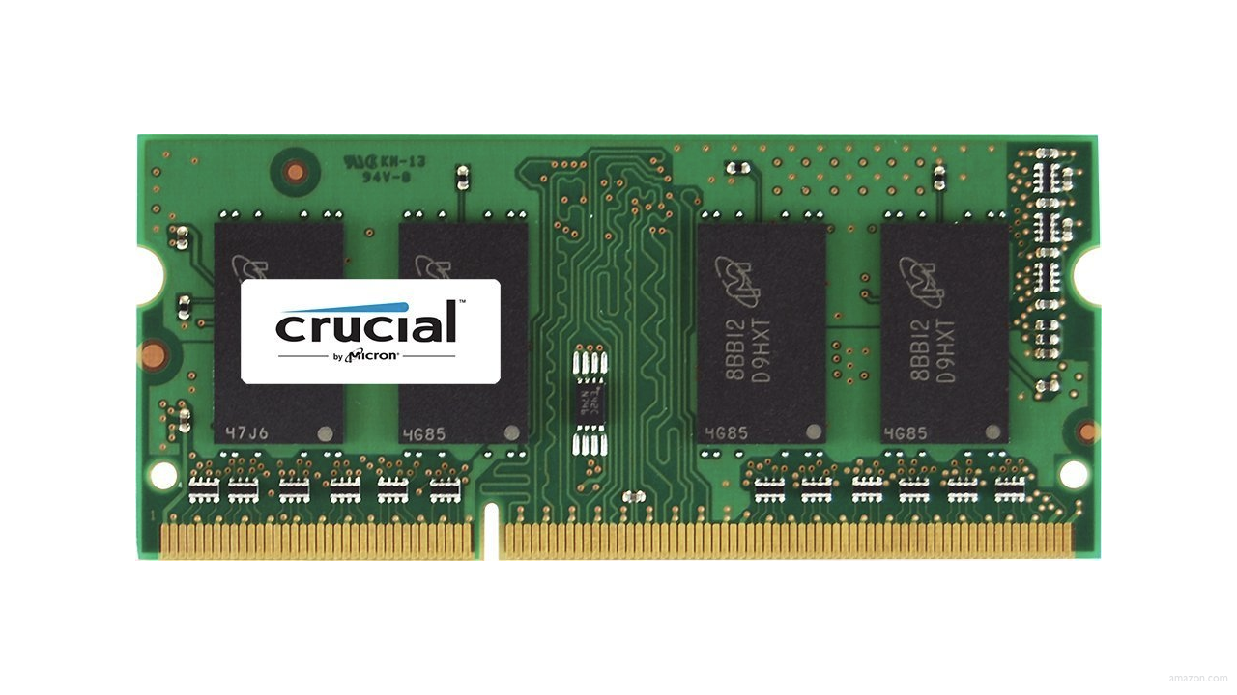

Slide 22
 | 1 | 5 | 10 | 20 | 50 | 100 | 500

Slide 24
 | [0] | [1] | [2] | [3] | [4] | [5] | [6]

Slide 25
 | [0] | [1] | [2] | [3] | [4] | [5] | [6]

Slide 26
searching

Slide 27
input →
→ output

Slide 28

→
→ output

Slide 29
→
→ bool

Slide 30
algorithm

Slide 31

Notes:
https://www.etsy.com/listing/926075105/monopoly-money-vintage-fabric-half-yard

Slide 32
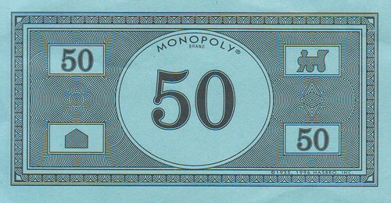
Notes:
https://www.pinterest.com/pin/525443481522247447/

Slide 33
linear search
Notes:
20 500 10 5 100 1 50

Slide 34
For each door from left to right
If 50 is behind door
Return true
Return false

Slide 35
For each door from left to right
If 50 is behind door
Return true
Else
Return false

Slide 36
For each door from left to right
If 50 is behind door
Return true
Return false

Slide 37
For i from 0 to n-1
If 50 is behind doors[i]
Return true
Return false

Slide 38
Notes:
https://www.pinterest.com/pin/525443481522247447/

Slide 39
binary search
Notes:
1 5 10 20 50 100 500

Slide 40
If 50 is behind middle door
Return true
Else if 50 < middle door
Search left half
Else if 50 > middle door
Search right half

Slide 41
If no doors left
If 50 is behind middle door
Return true
Else if 50 < middle door
Search left half
Else if 50 > middle door
Search right half

Slide 42
If no doors left
Return false
If 50 is behind middle door
Return true
Else if 50 < middle door
Search left half
Else if 50 > middle door
Search right half

Slide 43
If no doors left
Return false
If 50 is behind doors[middle]
Return true
Else if 50 < doors[middle]
Search doors[0] through doors[middle - 1]
Else if 50 > doors[middle]
Search doors[middle + 1] through doors[n - 1]

Slide 44
running time

Slide 45
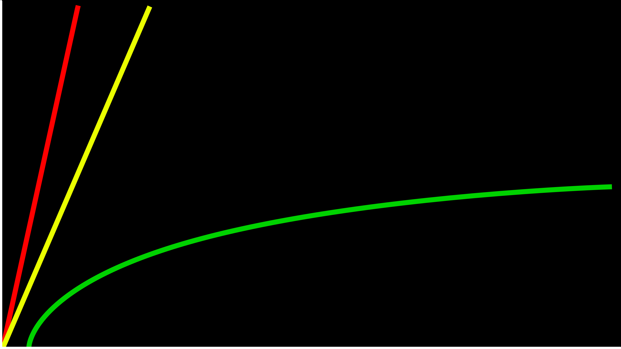
time to solve
size of problem

Slide 46
O(n)
O(n/2)
time to solve
O(log₂n)
size of problem

Slide 47
O(n)
O(n/2)
time to solve
O(log₂n)
size of problem

Slide 48
O(n)
O(n)
time to solve
O(log₂n)
size of problem

Slide 49
O(n)
O(n)
time to solve
O(log n)
size of problem

Slide 50
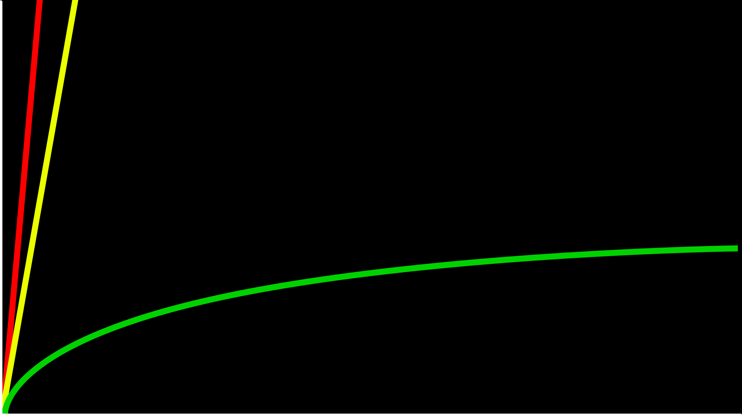
O(n)
time to solve
O(log n)
size of problem

Slide 51
O

Slide 52
O(n²)
O(n log n)
O(n)
O(log n)
O(1)
Notes:
linear? binary?

Slide 53
O(n²)
O(n log n)
O(n) linear search
O(log n)
O(1)

Slide 54
O(n²)
O(n log n)
O(n) linear search
O(log n) binary search
O(1)

Slide 55
Ω

Slide 56
Ω(n²)
Ω(n log n)
Ω(n)
Ω(log n)
Ω(1)
Notes:
linear? binary?

Slide 57
Ω(n²)
Ω(n log n)
Ω(n)
Ω(log n)
Ω(1) linear search

Slide 58
Ω(n²)
Ω(n log n)
Ω(n)
Ω(log n)
Ω(1) linear search, binary search

Slide 59
Θ

Slide 60
Θ(n²)
Θ(n log n)
Θ(n)
Θ(log n)
Θ(1)

Slide 61
asymptotic notation

Slide 62
linear search
Notes:
search0.c

Slide 63
string.h

Slide 64
manual.cs50.io/#string.h

Slide 65
strcmp
Notes:
search1.c, phonebook0.c

Slide 66
data structures

Slide 67
person people[2];

Slide 68
string name;
string number;

Slide 69
typedef struct
{
string name;
string number;
}
person;

Slide 70
typedef struct
{
string name;
string number;
} person;
Notes:
phonebook1.c
we'll see a way to save phonebook eventually

Slide 71
sorting

Slide 72
input →
→ output

Slide 73
unsorted →
→ output

Slide 74
unsorted →
→ sorted

Slide 75
→
→ sorted
7 2 5 4 1 6 0 3

Slide 76
→
→
7 2 5 4 1 6 0 3
0 1 2 3 4 5 6 7

Slide 77
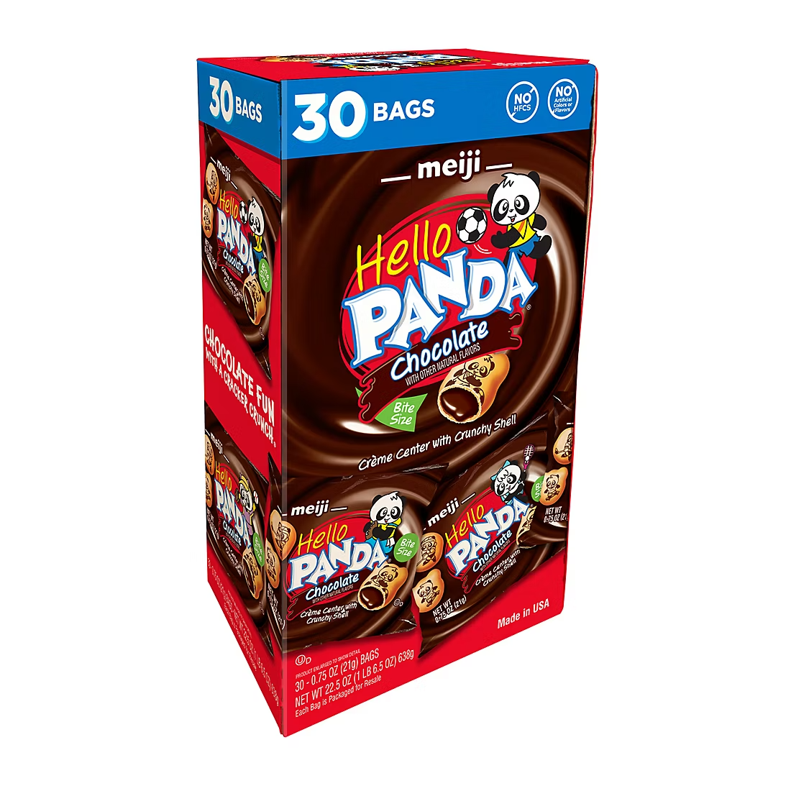

Slide 78
7 2 5 4 1 6 0 3
Notes:
volunteers: sort themselves, then selection, then bubble

Slide 79
selection sort
Notes:
https://www.cs.usfca.edu/~galles/visualization/ComparisonSort.html

Slide 80
 | [0] | [1] | [2] | ... | [n-3] | [n-2] | [n-1]

Slide 81
For i from 0 to n-1
Find smallest number between numbers[i] and numbers[n-1]
Swap smallest number with numbers[i]

Slide 82
7 2 5 4 1 6 0 3

Slide 83
7 2 5 4 1 6 0 3
[i]

Slide 84
7 2 5 4 1 6 0 3
[i]
[i]
[n-1]

Slide 85
7 2 5 4 1 6 0 3
[i]
[i]
[n-1]

Slide 86
7 2 5 4 1 6 0 3
[i]
[i]
[n-1]

Slide 87
7 2 5 4 1 6 0 3
[i]
[i]
[n-1]

Slide 88
7 2 5 4 1 6 0 3
[i]
[i]
[n-1]

Slide 89
7 2 5 4 1 6 0 3
[i]
[i]
[n-1]

Slide 90
0 2 5 4 1 6 7 3
[i]
[i]
[n-1]

Slide 91
0 2 5 4 1 6 7 3
[i]
[i]
[n-1]

Slide 92
0 2 5 4 1 6 7 3
[i]
[i]
[n-1]

Slide 93
0 2 5 4 1 6 7 3
[i]
[n-1]

Slide 94
(n – 1)

Slide 95
(n – 1) + (n – 2)

Slide 96
(n – 1) + (n – 2) + (n – 3)

Slide 97
(n – 1) + (n – 2) + (n – 3) + ... + 1

Slide 98
(n – 1) + (n – 2) + (n – 3) + ... + 1
n(n – 1)/2

Slide 99
(n – 1) + (n – 2) + (n – 3) + ... + 1
n(n – 1)/2
(n² – n)/2

Slide 100
(n – 1) + (n – 2) + (n – 3) + ... + 1
n(n – 1)/2
(n² – n)/2
n²/2 – n/2

Slide 101
(n – 1) + (n – 2) + (n – 3) + ... + 1
n(n – 1)/2
(n² – n)/2
n²/2 – n/2
O(n²)

Slide 102
O(n²)
O(n log n)
O(n)
O(log n)
O(1)

Slide 103
O(n²) selection sort
O(n log n)
O(n)
O(log n)
O(1)

Slide 104
For i from 0 to n-1
Find smallest number between numbers[i] and numbers[n-1]
Swap smallest number with numbers[i]
Notes:
what about lower bound?

Slide 105
 | [0] | [1] | [2] | ... | [n-3] | [n-2] | [n-1]

Slide 106
Ω(n²)
Ω(n log n)
Ω(n)
Ω(log n)
Ω(1)

Slide 107
Ω(n²) selection sort
Ω(n log n)
Ω(n)
Ω(log n)
Ω(1)

Slide 108
Θ(n²)
Θ(n log n)
Θ(n)
Θ(log n)
Θ(1)

Slide 109
Θ(n²) selection sort
Θ(n log n)
Θ(n)
Θ(log n)
Θ(1)

Slide 110
bubble sort
Notes:
https://www.cs.usfca.edu/~galles/visualization/ComparisonSort.html

Slide 111
 | [0] | [1] | [2] | ... | [n-3] | [n-2] | [n-1]

Slide 112
Repeat n times
For i from 0 to n-2
If numbers[i] and numbers[i+1] out of order
Swap them

Slide 113
Repeat n-1 times
For i from 0 to n-2
If numbers[i] and numbers[i+1] out of order
Swap them

Slide 114
7 2 5 4 1 6 0 3

Slide 115
7 2 5 4 1 6 0 3
[i] [i+1]

Slide 116
2 7 5 4 1 6 0 3
[i] [i+1]

Slide 117
2 7 5 4 1 6 0 3
[i] [i+1]

Slide 118
2 5 7 4 1 6 0 3
[i] [i+1]

Slide 119
2 5 7 4 1 6 0 3
[i] [i+1]

Slide 120
2 5 4 7 1 6 0 3
[i] [i+1]

Slide 121
2 5 4 7 1 6 0 3
[i] [i+1]

Slide 122
2 5 4 1 7 6 0 3
[i] [i+1]

Slide 123
2 5 4 1 7 6 0 3
[i] [i+1]

Slide 124
2 5 4 1 6 7 0 3
[i] [i+1]

Slide 125
2 5 4 1 6 7 0 3
[i] [i+1]

Slide 126
2 5 4 1 6 0 7 3
[i] [i+1]

Slide 127
2 5 4 1 6 0 7 3
[i] [i+1]

Slide 128
2 5 4 1 6 0 3 7
[i] [i+1]

Slide 129
2 5 4 1 6 0 3 7
[i] [i+1]

Slide 130
Repeat n-1 times
For i from 0 to n-2
If numbers[i] and numbers[i+1] out of order
Swap them

Slide 131
Repeat n-1 times n-1
For i from 0 to n-2
If numbers[i] and numbers[i+1] out of order
Swap them

Slide 132
Repeat n-1 times n-1
For i from 0 to n-2 n-1
If numbers[i] and numbers[i+1] out of order
Swap them

Slide 133
Repeat n-1 times n-1
For i from 0 to n-2 n-1
If numbers[i] and numbers[i+1] out of order 1
Swap them

Slide 134
Repeat n-1 times n-1
For i from 0 to n-2 n-1
If numbers[i] and numbers[i+1] out of order 4
Swap them

Slide 135
Repeat n-1 times n-1
For i from 0 to n-2 n-1
If numbers[i] and numbers[i+1] out of order
Swap them

Slide 136
(n – 1) × (n – 1)

Slide 137
(n – 1) × (n – 1)
n² – 1n – 1n + 1

Slide 138
(n – 1) × (n – 1)
n² – 1n – 1n + 1
n² – 2n + 1

Slide 139
(n – 1) × (n – 1)
n² – 1n – 1n + 1
n² – 2n + 1
O(n²)

Slide 140
O(n²)
O(n log n)
O(n)
O(log n)
O(1)

Slide 141
O(n²) bubble sort
O(n log n)
O(n)
O(log n)
O(1)

Slide 142
Repeat n-1 times
For i from 0 to n-2
If numbers[i] and numbers[i+1] out of order
Swap them

Slide 143
Repeat n-1 times
For i from 0 to n-2
If numbers[i] and numbers[i+1] out of order
Swap them
If no swaps
Quit

Slide 144
Ω(n²)
Ω(n log n)
Ω(n)
Ω(log n)
Ω(1)

Slide 145
Ω(n²)
Ω(n log n)
Ω(n) bubble sort
Ω(log n)
Ω(1)

Slide 146
recursion

Slide 147
If no doors left
Return false
If number behind middle door
Return true
Else if number < middle door
Search left half
Else if number > middle door
Search right half

Slide 148
If no doors left
Return false
If number behind middle door
Return true
Else if number < middle door
Search left half
Else if number > middle door
Search right half

Slide 149
1 Pick up phone book
2 Open to middle of phone book
3 Look at page
4 If person is on page
5 Call person
6 Else if person is earlier in book
7 Open to middle of left half of book
8 Go back to line 3
9 Else if person is later in book
10 Open to middle of right half of book
11 Go back to line 3
12 Else
13 Quit

Slide 150
1 Pick up phone book
2 Open to middle of phone book
3 Look at page
4 If person is on page
5 Call person
6 Else if person is earlier in book
7 Open to middle of left half of book
8 Go back to line 3
9 Else if person is later in book
10 Open to middle of right half of book
11 Go back to line 3
12 Else
13 Quit

Slide 151
1 Pick up phone book
2 Open to middle of phone book
3 Look at page
4 If person is on page
5 Call person
6 Else if person is earlier in book
7 Open to middle of left half of book
8 Go back to line 3
9 Else if person is later in book
10 Open to middle of right half of book
11 Go back to line 3
12 Else
13 Quit

Slide 152
1 Pick up phone book
2 Open to middle of phone book
3 Look at page
4 If person is on page
5 Call person
6 Else if person is earlier in book
7 Search left half of book
8
9 Else if person is later in book
10 Search right half of book
11
12 Else
13 Quit

Slide 153
1 Pick up phone book
2 Open to middle of phone book
3 Look at page
4 If person is on page
5 Call person
6 Else if person is earlier in book
7 Search left half of book
8 Else if person is later in book
9 Search right half of book
10 Else
11 Quit

Slide 154

Notes:
http://ian-albert.com/games/super_mario_bros_maps/

Slide 155

Notes:
iteration.c

Slide 156


Slide 157


Slide 158


Slide 159

Notes:
recursion.c

Slide 160
google.com/search?q=recursion

Slide 161
merge sort

Slide 162
Sort left half of numbers
Sort right half of numbers
Merge sorted halves

Slide 163
If only one number
Quit
Else
Sort left half of numbers
Sort right half of numbers
Merge sorted halves

Slide 164
If only one number
Quit
Else
Sort left half of numbers
Sort right half of numbers
Merge sorted halves

Slide 165
1 3 4 6 0 2 5 7
Notes:
shelves

Slide 166
If only one number
Quit
Else
Sort left half of numbers
Sort right half of numbers
Merge sorted halves
Notes:
https://www.cs.usfca.edu/~galles/visualization/ComparisonSort.html

Slide 167
6 3 4 1 5 2 7 0
Notes:
shelves

Slide 168
6 | 3 | 4 | 1 | 5 | 2 | 7 | 0

Slide 169
6 | 3 | 4 | 1 | 5 | 2 | 7 | 0

Slide 170
 |  |  |  | 5 | 2 | 7 | 0
6 | 3 | 4 | 1

Slide 171
 |  |  |  | 5 | 2 | 7 | 0
 |  | 4 | 1
6 | 3

Slide 172
 |  |  |  | 5 | 2 | 7 | 0
 |  | 4 | 1
 | 3
6

Slide 173
 |  |  |  | 5 | 2 | 7 | 0
 |  | 4 | 1
6
3

Slide 174
 |  |  |  | 5 | 2 | 7 | 0
 |  | 4 | 1
3
6

Slide 175
 |  |  |  | 5 | 2 | 7 | 0
 |  | 4 | 1
3 | 6

Slide 176
 |  |  |  | 5 | 2 | 7 | 0
3 | 6
4 | 1

Slide 177
 |  |  |  | 5 | 2 | 7 | 0
3 | 6
 | 1
4

Slide 178
 |  |  |  | 5 | 2 | 7 | 0
3 | 6
4
1

Slide 179
 |  |  |  | 5 | 2 | 7 | 0
3 | 6
1
4

Slide 180
 |  |  |  | 5 | 2 | 7 | 0
3 | 6
1 | 4

Slide 181
 |  |  |  | 5 | 2 | 7 | 0
1
3 | 6
 | 4

Slide 182
 |  |  |  | 5 | 2 | 7 | 0
1 | 3
 | 6
 | 4

Slide 183
 |  |  |  | 5 | 2 | 7 | 0
1 | 3 | 4
 | 6

Slide 184
 |  |  |  | 5 | 2 | 7 | 0
1 | 3 | 4 | 6

Slide 185
1 | 3 | 4 | 6
5 | 2 | 7 | 0

Slide 186
1 | 3 | 4 | 6
 |  | 7 | 0
5 | 2

Slide 187
1 | 3 | 4 | 6
 |  | 7 | 0
 | 2
5

Slide 188
1 | 3 | 4 | 6
 |  | 7 | 0
5
2

Slide 189
1 | 3 | 4 | 6
 |  | 7 | 0
2
5

Slide 190
1 | 3 | 4 | 6
 |  | 7 | 0
2 | 5

Slide 191
1 | 3 | 4 | 6
2 | 5
7 | 0

Slide 192
1 | 3 | 4 | 6
2 | 5
 | 0
7

Slide 193
1 | 3 | 4 | 6
2 | 5
7
0

Slide 194
1 | 3 | 4 | 6
2 | 5
0
7

Slide 195
1 | 3 | 4 | 6
2 | 5
0 | 7

Slide 196
1 | 3 | 4 | 6
0
2 | 5
 | 7

Slide 197
1 | 3 | 4 | 6
0 | 2
 | 5
 | 7

Slide 198
1 | 3 | 4 | 6
0 | 2 | 5
 | 7

Slide 199
1 | 3 | 4 | 6
0 | 2 | 5 | 7

Slide 200
0
1 | 3 | 4 | 6
 | 2 | 5 | 7

Slide 201
0 | 1
 | 3 | 4 | 6
 | 2 | 5 | 7

Slide 202
0 | 1 | 2
 | 3 | 4 | 6
 |  | 5 | 7

Slide 203
0 | 1 | 2 | 3
 |  | 4 | 6
 |  | 5 | 7

Slide 204
0 | 1 | 2 | 3 | 4
 |  |  | 6
 |  | 5 | 7

Slide 205
0 | 1 | 2 | 3 | 4 | 5
 |  |  | 6
 |  |  | 7

Slide 206
0 | 1 | 2 | 3 | 4 | 5 | 6
 |  |  | 7

Slide 207
0 | 1 | 2 | 3 | 4 | 5 | 6 | 7

Slide 208
0 | 1 | 2 | 3 | 4 | 5 | 6 | 7

Slide 209
O(n²)
O(n log n)
O(n)
O(log n)
O(1)

Slide 210
6 | 3 | 4 | 1 | 5 | 2 | 7 | 0
6 | 3 | 4 | 1
5 | 2 | 7 | 0
6 | 3
4 | 1
5 | 2
7 | 0
6
3
4
1
5
2
7
0

Slide 211
6 | 3 | 4 | 1 | 5 | 2 | 7 | 0
6 | 3 | 4 | 1
5 | 2 | 7 | 0
6 | 3
4 | 1
5 | 2
7 | 0
6
3
4
1
5
2
7
0

Slide 212
log₂ n

Slide 213
log₂ 8

Slide 214
log₂ 2³

Slide 215
3

Slide 216
6 | 3 | 4 | 1 | 5 | 2 | 7 | 0
6 | 3 | 4 | 1
5 | 2 | 7 | 0
6 | 3
4 | 1
5 | 2
7 | 0
6
3
4
1
5
2
7
0

Slide 217
n log₂ n

Slide 218
n log n

Slide 219
O(n²)
O(n log n) merge sort
O(n)
O(log n)
O(1)

Slide 220
Ω(n²)
Ω(n log n) merge sort
Ω(n)
Ω(log n)
Ω(1)

Slide 221
Θ(n²)
Θ(n log n) merge sort
Θ(n)
Θ(log n)
Θ(1)

Slide 222
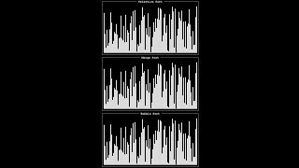
Notes:
Source: https://www.youtube.com/watch?v=ZZuD6iUe3Pc
https://www.youtubeeducation.com/watch?v=3WDWH59k1q4

Slide 223
Notes:
Reload codespace
Uncheck VS Code tabs

